Slide 1
Short-sighted evolution of Influenza cellular receptor binding avidity
Authours:
Hsiang-Yu Yuan
James Hay
Katia Koelle

Slide 2
figure1: The binding avidity changes of single amino acid mutations by net charge
BindingAnal\validate_netcharge\plot_bindingchanges.R
figure2: Net charge distribution by age group
BindingAnal\validate_netcharge\netcharge_age19.R
figure3: Within host reproductive number and the probability of infection
BindingAnal\fitness\tradeoff\Mtradeoff\plot_Rin_infection.m; plot_prob_infection.m; plot_prob_infection_m2.m
figure4: Simulated epidemic with and without within-host binding avidity adaptation
BindingAnal\fitness\tradeoff\Mtradeoff\dat\lowV0 ??
BindingAnal\fitness\tradeoff\Mtradeoff\dat\highV0 ??
figure5: Distribution of population immunity during the epidemic with binding avidity adaptation
figure6: The effective reproductive number by time and binding avidity
BindingAnal\fitness\tradeoff\Mtradeoff\plotPopRfromSkwithBinding.R
figure7: Within-host and between-host relative fitness by binding avidity and antigenic changes
BindingAnal\fitness\tradeoff\Mtradeoff\figs\fitness\plotMutSelBalance_3D.m
figure8: The deleterious effect of within-host binding avidity adaptation on viral phylogeny
BindingAnal\ParseTree\mat\Mparsetree\plotNetchargeByTimeSim.m
Figure9: Phylogenetic analysis of cellular receptor binding avidity
BindingAnal\ParseTree\mat\Mparsetree\scripts.txt

Slide 3
Batch Analysis
1. Cluster_setup.R is code specific to creating a link to the Imperial cluster - you do not need this.
2. Yes, you should just use run_all directly in this case.
3. If you run source("cluster_submission.R") this should load the run_all() function into the environment.
4. Correct - run_simulation_cpp() is an R wrapper to some C++ code, so can be treated as an R function. It is compiled with devtools::load_all().

Slide 4
Suggestions
1. Move Figure2 to supplementary: it gives supporting evidence of binding avidity selection.
2. Move Figure7 to Figure2.

Slide 5
figure1: The binding avidity changes of single amino acid mutations by net charge
Notes:
Source:
Github\BindingAnal\validate_netcharge\plot_bindingchanges.R
Legend:
Figure1. Binding avidity change of single amino acid mutations by net charge. The value is calculated as the log ratio of RDE activity of the mutant to that of the wild type. Amino acid mutations are grouped in 3 categories. Increase represents amino acid changes that increase net charge by 1 or 2 units. Decrease represents the amino acid changes that decrease net charge by 1 or 2 units. Same represents net charge is same. Aspartate (D), glutamate (E) are counted as negatively charged amino acids (-1) and Histidine (H), Arginine (R), Lysine (K) are counted as positively charged (+1).

Slide 6
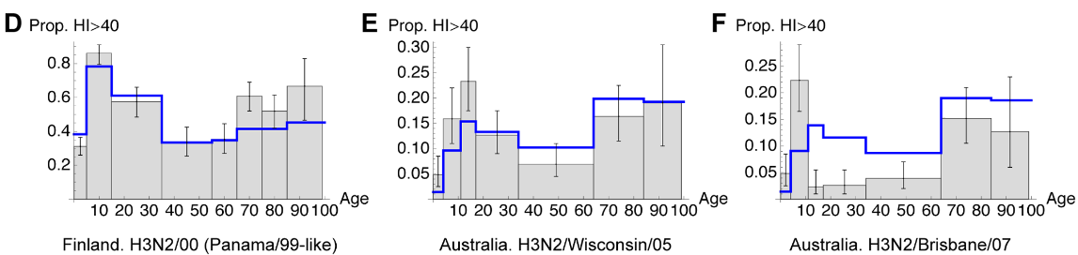
figure2: Net charge distribution by age group
AJ Kucharski ‎2012 Plos CompBio
Notes:
Suggestion: Move Figure2 to supplementary
Source:
Github\BindingAnal\validate_netcharge\netcharge_age19.R
#Make another graph using smoothing algorithm
Legend:
Figure2. Net charge distribution by age group. The proportion of higher net charge is calculated for 5 age groups (0-19, 20-39, 40-59, 60-79 and $\geq80$). Virus sequences and clinical data are obtained from the Influenza Genome Sequencing Project (\cite{Ghedin2005}) and the Influenza Virus Resource Database (\cite{Bao2008}).

Slide 7
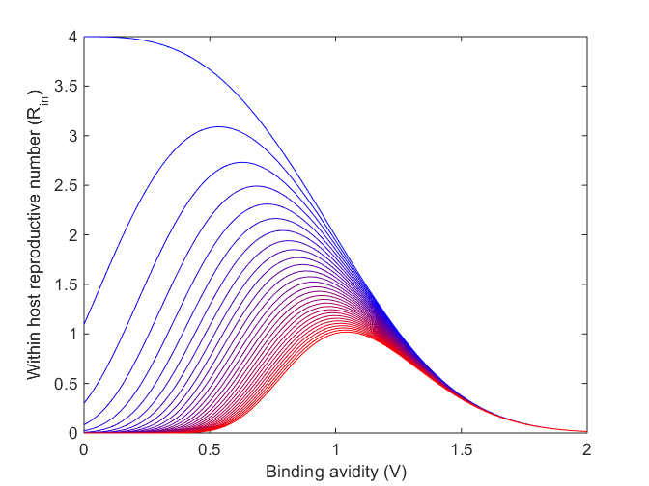
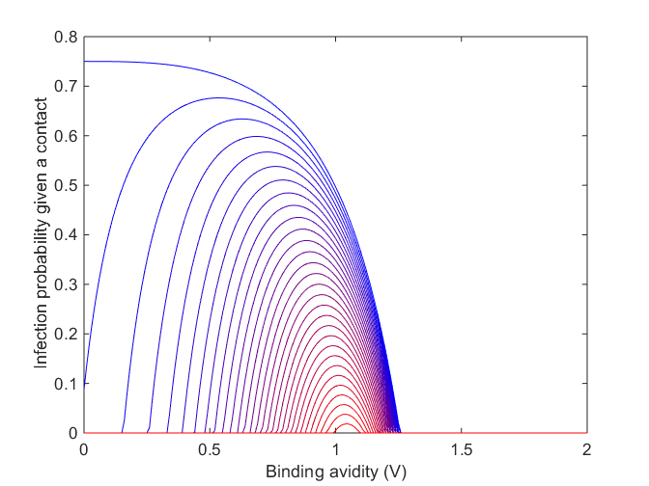
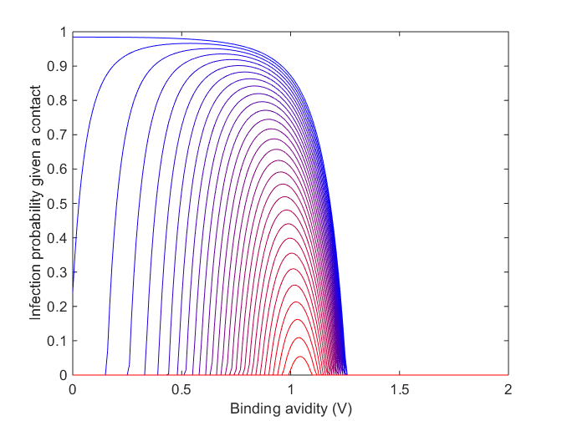
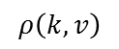
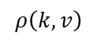
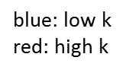
figure3: Within host reproductive number and the probability of infection
$$ρ\left(k,v\right)$$
$$ρ\left(k,v\right)$$
blue: low k
red: high k
Notes:
Summary:
and (B) were plotted using the default parameters setting.
(C) used the alternative parameters setting without differential selection.
Source:
(A) >> Github\BindingAnal\fitness\tradeoff\Mtradeoff\plot_Rin_infection.m
(B) >> Github\BindingAnal\fitness\tradeoff\Mtradeoff\plot_prob_infection.m
(C) is the alternative fitness profile (without differential selection). Needs to make sure the parameters values.
(C) >> Github\BindingAnal\fitness\tradeoff\Mtradeoff\plot_prob_infection_m2.m
Legend:
Figure3. Within host reproductive number and the probability of infection. (A) Within-host fitness represented by the expected within-host reproductive number $R_{in}$. Parameters for within-host immune escape and replication cost were set as p=4, r=70, a=0.7 and b=3, and virus offspring number was set to $n=4$ (see Methods section for parameter descriptions). Bluer colours indicate more immunologically naive individuals, whereas redder colours indicate higher immunity individuals. (B) The probability of infection with differential selection. Within-host parameters values are same as (A) and the effective initial number of transmitted virions was $\sigma$=1. (C) The probability of infection with weak differential selection. Parameter values same as (A) but the effective initial number of the transmitted virions was $\sigma$=3 to represent a higher viral dosage as would be the case in serial passaging transmission.

Slide 8
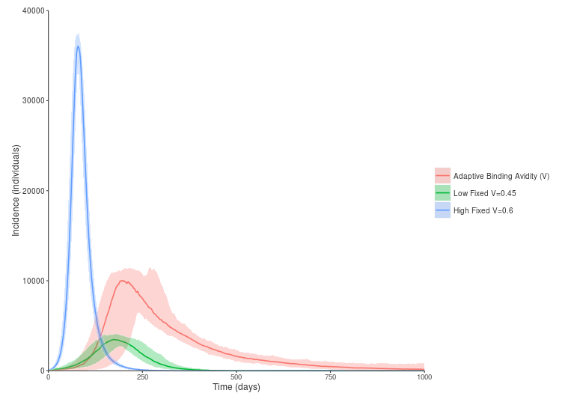
figure4: Simulated epidemic with and without within-host binding avidity adaptation
epidemic dynamics
immunological dynamics
Notes:
Source:
The figure is produced from IBM. (The script was written by James. Please update.)
workdir Github\BindingAnal\fitness\tradeoff\Mtradeoff\dat\lowV0
workdir Github\BindingAnal\fitness\tradeoff\Mtradeoff\dat\highV0
Parameters setting:
Low fixed V=0.45
High Fixed V=0.6
Adaptive binding V0=0.45
D = 1000day
birth rate = 40; pop = 500,000; mut = 0.05; Shape of mutation distribution = 1.3
Legend:
Figure4. Simulated epidemic with and without within-host binding avidity adaptation. An antigenic strain with $\delta=2$ is introduced without continual antigenic drift during the epidemics, $\kappa_{a}=0$ and $\kappa_{b}=0$. The red line shows the incidence when binding avidity is allowed to adapt within hosts over the course of the epidemic, starting at a binding avidity of V=0.45. The blue line shows incidence when binding avidity is fixed near the late stage population average of V=0.6, eliciting a rapid, large peak. The green line shows the incidence when binding avidity is fixed near the early phase population average at $V=0.45$, resulting in a very small epidemic peak. In all scenarios, Total population $N$ is set to be 1,000,000. For the initial day, the number of seed viruses $I_{0} = 100$, recovered hosts $R$ = 0 and the remaining hosts were susceptible under the initial immunity distribution as described in the Methods. The remaining epidemiological parameters were described in TableS4. Within host parameters were as described in FigureS1.

Slide 9
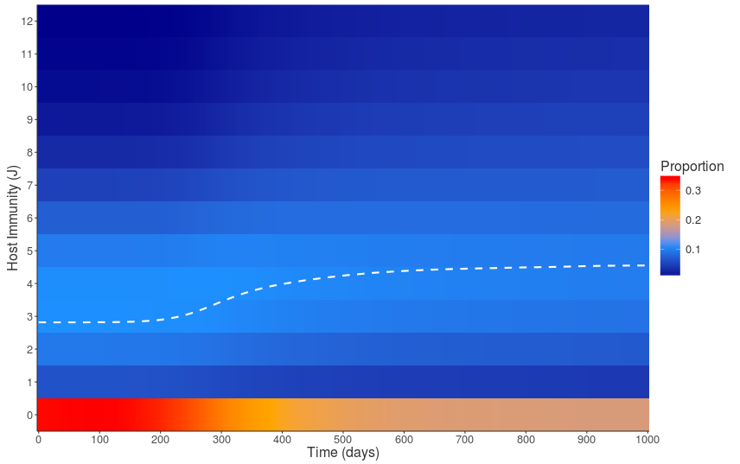
figure5: Distribution of population immunity during the epidemic with binding avidity adaptation
Notes:
Source:
The figure is produced from IBM output. (The script was written by James. Please update.)
Parameters setting as Figure4:
Low fixed V=0.45
High Fixed V=0.6
Adaptive binding V0=0.45
D = 1000day
Legend:
Figure5. Distribution of population immunity during the epidemic with binding avidity adaptation. Colours show the proportion of susceptible hosts with a given level of effective immunity against the seed virus, J, over time. The white line represents the population mean immunity level. At the start of the simulation, the majority of hosts are completely naive to the novel strain, with some hosts exhibiting low levels of immunity due to prior infection. As incidence increases, the mean host immunity also increases as infected hosts recover and develop long-term immunity. This coincides with the peak of incidence at around 200 days. Parameters are as described in Figure4 and Figure3.

Slide 10
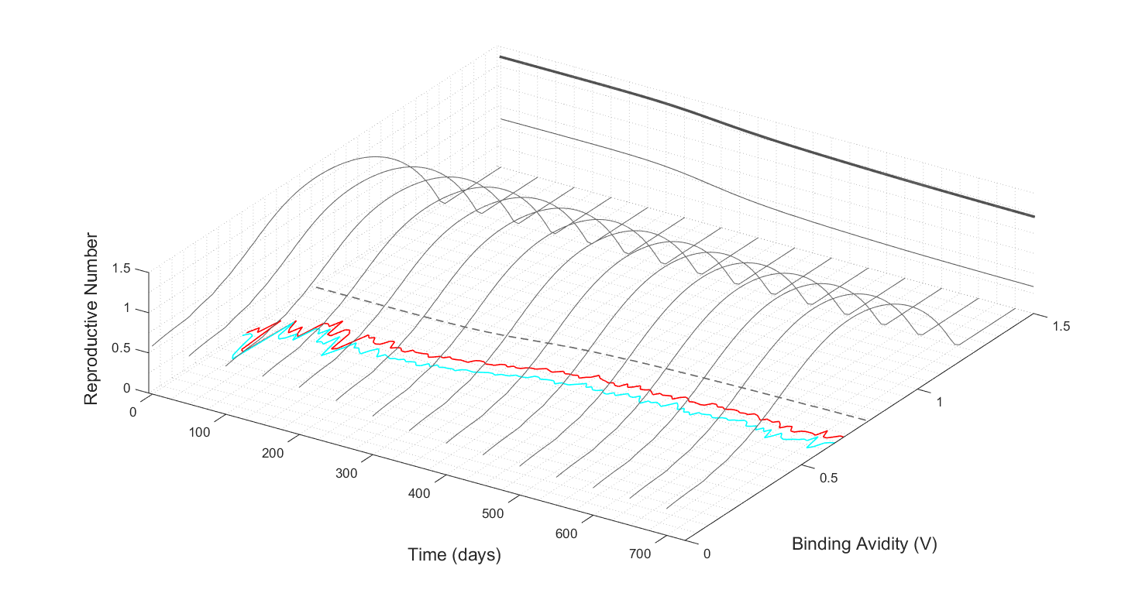
figure6: The effective reproductive number by time and binding avidity
Notes:
Summary:
Dashed: Optimum binding avidity
Red: Initial binding avidity
Cyan: Final binding avidity
Source:
Workdir: Github\BindingAnal\fitness\tradeoff\Mtradeoff
function: plotPopRfromSkwithBinding(infile, infileV)
example:
infileV = 'dat/lowV0/voutput1_low_adaptive.csv';
infile = 'dat/lowV0/hostKs_low_adaptive.csv'
plotPopRfromSkwithBinding(infile, infileV), this file plot the population level reproductive number R
It will produce Mtradeoff\dat\lowV0\virusbinding.mat(voutput_binding.mat), which contains
Vfinal, Vini and Vopt. This file will be called infileB later, which is used as an input data by the function plotNetchargeByTimeSim(infile, infileB) in Mparsetree (see figure8 descriptions).
Legend:
Figure6. The effective reproductive number by time and binding avidity. The effective reproductive number was calculated against the population contained only susceptible individuals with differential protection (as in Figure5) but excluding the transiently recovered and infected individuals. The optimum binding avidity (dotted line) is that which produces the largest number of offspring at the population level. The effective reproductive number produced by the optimum binding avidity was projected to the bold gray line. Red, the mean binding avidity across all extant virions at the start of the infectious period. Light blue, the mean final binding avidity across all extant virions at the end of the infectious period. Bold gray, the optimum reproductive number. Thin gray, the effective reproductive number when binding avidity is fixed at 0.

Slide 11
figure7: Within-host and between-host relative fitness by binding avidity and antigenic changes
Notes:
Source:
figure: workdir Github\BindingAnal\fitness\tradeoff\Mtradeoff\figs\fitness
workdir Github\BindingAnal\fitness\tradeoff\Mtradeoff
function: plotMutSelBalance_3D()
input: infile = dat/lowV0/hostKs_low_adaptive.csv
#plotMutSelBalanceT200_3D, why there is an error message?
20170426
Check the following line?
opt = fminunc(f,[v1,v2]);
Vopt = fminunc(f,[v2]);
Legned:
Figure7. Within-host and between-host relative fitness by binding avidity and antigenic change. Within-host relative fitness is shown by the red surface. Between-host relative fitness is shown by the surface ranging from blue (low) to yellow (high) to represent the value from low to high.

Slide 12
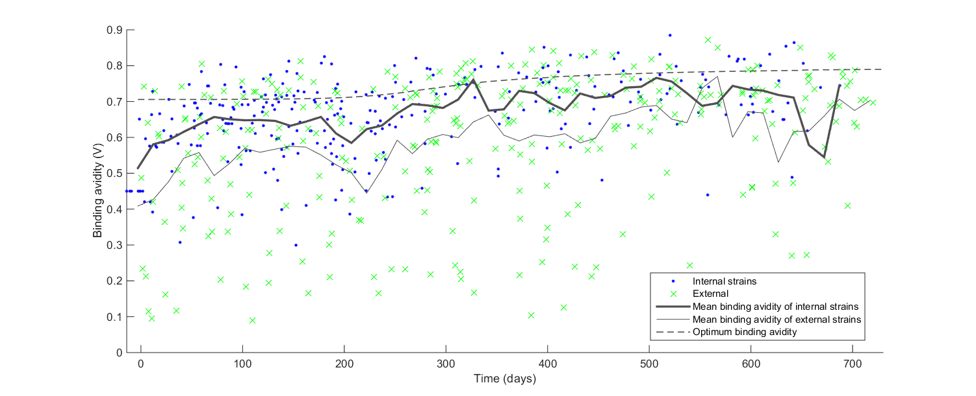
figure8: The deleterious effect of within-host binding avidity adaptation on viral phylogeny
Notes:
Change it to simulated binding avidity.
workdir: E:\Documents\Github\BindingAnal\ParseTree\mat\Mparsetree
function: plotNetchargeByTimeSim(infile, infileB)
infile = ‘dat/lowV0/voutput1_low_adaptive_tree_300_simple.mat’
infileB = ‘dat/lowV0/virusbinding_low_adaptive.mat’
How to generate infile simple.mat?
The simple.mat contains 3 columns b, d, names. The file will be produced in the function make_infection_tree/BuildTree_indiv_nexus(filename, n_seqs)
This function will be called by main_generate_tree() and the [filename_infectionTreeData]_simple.mat will be produced.
How to generate infileB mat file.
infileB contrains vopt, it is produced in the function plotPopRfromSk.
The file is generated by plotPopRfromSkwithBinding (see figure6 descriptions).
#Only needs to be used for single epidemic peak
Legend:
Figure8. The deleterious effect of within-host binding avidity adaptation on viral phylogeny . Blue dots represent internal nodes from the viral phylogeny. Green dots represent external tips from the viral phylogeny. The dotted line shows the optimum virus binding avidity that will produce the greatest number of offspring at the population level. Bold gray represents mean binding avidity from internal nodes. Light gray represents mean binding avidity from external nodes Parameter values were as described in Figure3A and B.

Slide 13
Figure9: Phylogenetic analysis of cellular receptor binding avidity
For all internal nodes, only 7.7% of the strains showed netcharge change
whereas in external tips, which were destined to die out soon, a higher proportion of the strains (11.8%) changed the netcharge
Notes:
Studies showed that higher ratios of non-synonymous-to-synonymous substitutions on external tree branches relative to those found internally (http://dx.doi.org/10.1093/molbev/msm001).
workdir: E:\Documents\Github\BindingAnal\ParseTree\mat\Mparsetree
1. To compare the variance between internal and external nodes
[netcharge ] = calNetCharge( )
How I produce the following values? Check the scripts.txt
internal vs external
proportion of netcharge change (7.8% vs 12.1%)
the variance (1.13 vs 1.18)
netcharge prevalence(>18) (20.0% vs 18.7%)
2. To find out the
which code produce this hm_h3n2_ny_charge_1993_2006.mat and newick_elements.mat?
hm_h3n2_ny_charge_1993_2006.mat is not consistent to my tree file
Legend:
Figure9. Phylogenetic analysis of cellular receptor binding avidity. (A) The maximum clade credibility (MCC) tree for the H3N2 viral isolates from New York State, with HA net charge values mapped onto all inferred internal nodes and all observed external nodes. Numbers next to the bracketed clades denote the $\#NGS$ group. (B) Viral net charge dynamics over time. Each point represents a node from (A) and is colored by whether it is classified as an internal trunk node (red circle), an internal non-trunk node (blue dot), or an external node (green ‘x’). Its placement along the x-axis corresponds to the inferred or observed time of the node in the phylogeny. Its placement along the y-axis corresponds to its calculated net charge value. Each of the four subplots shows viral net charge dynamics for a single $\#NGS$ group. The total number of net charge changes occurring along internal branches (including trunk and non-trunk internal branches) was approximately $40\%$ less than the total number of net charge changes occurring along external branches. Normalizing by total branch lengths of internal and external branches yielded similar results, with fewer net charge changes occurring per unit time on internal relative to external branches.

Slide 14
Figure10: Phylogeny of influenza viruses with drift and binding avidity
Notes:
Display the phylogenetic tree with and without the impact of binding avidity.
Parameters setting:
p 4 r 70 q 1 a 0.7 b 3 n 4 v 1 probMut 0.05 expDist 1.3 kc 0.05 VtoD 0.5 s0 499900 i0 100 r0 0 c 0.7 mu 3.91389432485323e-05 w 0.04 g 0.303030303030303 iniBind 0.6 meanBoost 8 iniDist 20 saveFreq 5 maxTitre 25

Slide 15
FigureS1. The relative binding avidity by absolute net charge
Notes:
E:\Documents\Github\BindingAnal\validate_netcharge\plot_bindingchanges_abs_reg.R

Slide 16
FigureS2: Changes of within- and between-host relative fitness by time during the epidemics
Notes:
To be changed: Make it as 3d surface
workdir: E:\Documents\Github\BindingAnal\fitness\tradeoff\Mtradeoff
infile = 'dat/lowV0/hostKs_low_adaptive.csv‘
infileV = ??
plotMutSelBalance(infile)

Slide 17
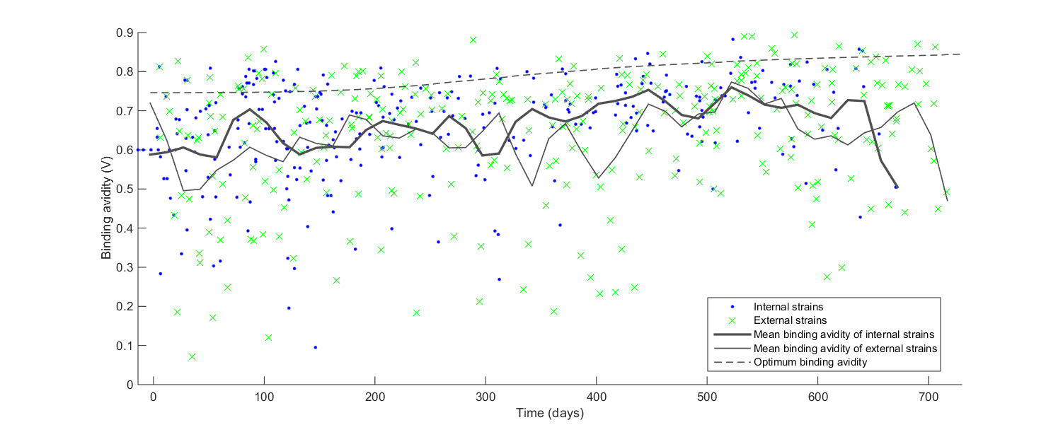
FigureS3: The neutral effect of within-host binding avidity adaptation on viral phylogeny
Notes:
voutput1_low_adaptive_tree_300_simple.png
workdir: E:\Documents\Github\BindingAnal\ParseTree\mat\Mparsetree
plotNetchargeByTimeSim(infile, infileB)
infile = ‘dat/highVirus/voutput1_highv_tree_300_simple.mat’
infileB = ‘dat/highVirus/virusbinding.mat’

Slide 18

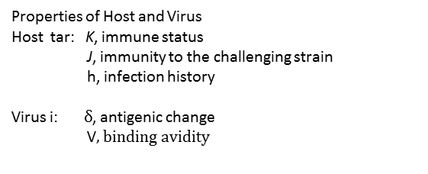
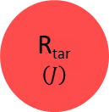
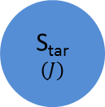
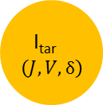
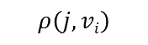

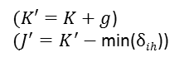
FigureS4: Schema of the disease transmission in the individual-based model
Properties of Host and Virus
Host tar: K, immune status
J, immunity to the challenging strain
h, infection history
Virus i: $δ$, antigenic change
V$, binding avidity$
I_{src}$\left(J,V,δ\right)$
$$ρ\left(j,vi\right)$$
S_{tar}
$$\left(J\right)$$
I_{tar}$\left(J,V,δ\right)$
R_{tar}
$$\left(J\right)$$
γ
$$w$$
$(K′=K+g$)
$(J^{′}=K^{′}−$ min($δih$))

Slide 19
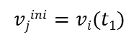
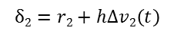
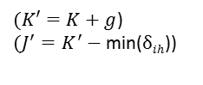
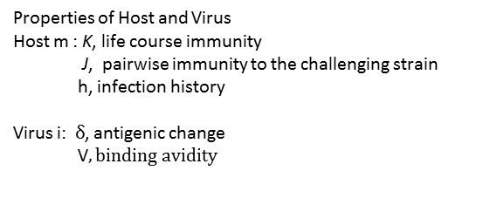
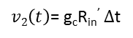
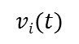
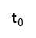
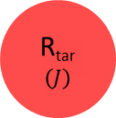
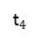
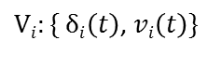
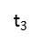
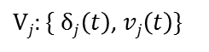

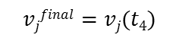
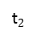
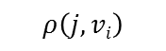
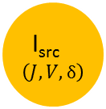
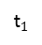
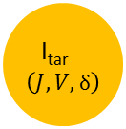
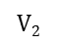
FigureS4: Schema of the disease transmission in the individual-based model
Properties of Host and Virus
Host m : K, life course immunity
J, pairwise immunity to the challenging strain
h, infection history
Virus i: $δ$, antigenic change
V$, binding avidity$
I_{src}$\left(J,V,δ\right)$
$$ρ\left(j,vi\right)$$
S_{tar}
$$\left(J\right)$$
I_{tar}$\left(J,V,δ\right)$
R_{tar}
$$\left(J\right)$$
γ
$$w$$
$(K′=K+g$)
$(J^{′}=K^{′}−$ min($δih$))
$Vj:\{ δj\left(t\right)$, $vj\left(t\right)\}$
$$vjfinal=vj(t4)$$
$$vjini=vi(t1)$$
$Vi:\{ δi\left(t\right)$, $vi\left(t\right)\}$
$$vi(t)$$
t$0$
t$1$
t$2$
t$3$
t$4$
$$V2$$
$$δ2=r2+hΔv2\left(t\right)$$
$v2\left(t\right)$= g_{c}R_{in}’ $Δ$t

Slide 20
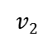
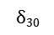
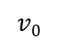
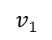
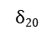
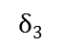
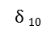
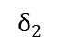
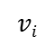
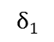
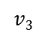
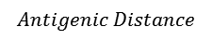
$$vi$$
$$δ3$$
$$δ2$$
$$v3$$
$$δ1$$
$$v2$$
$$v1$$
$$v0$$
0
$$δ 10$$
$$δ20$$
$$δ30$$
$$Antigenic Distance$$
Notes:
Needs another diagram to illustrate effective immune status

Slide 21
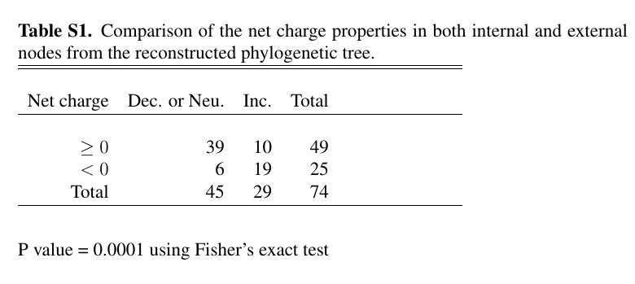

Slide 22


Slide 23

TableS3. validate_netcharge.csv

